Slide 1

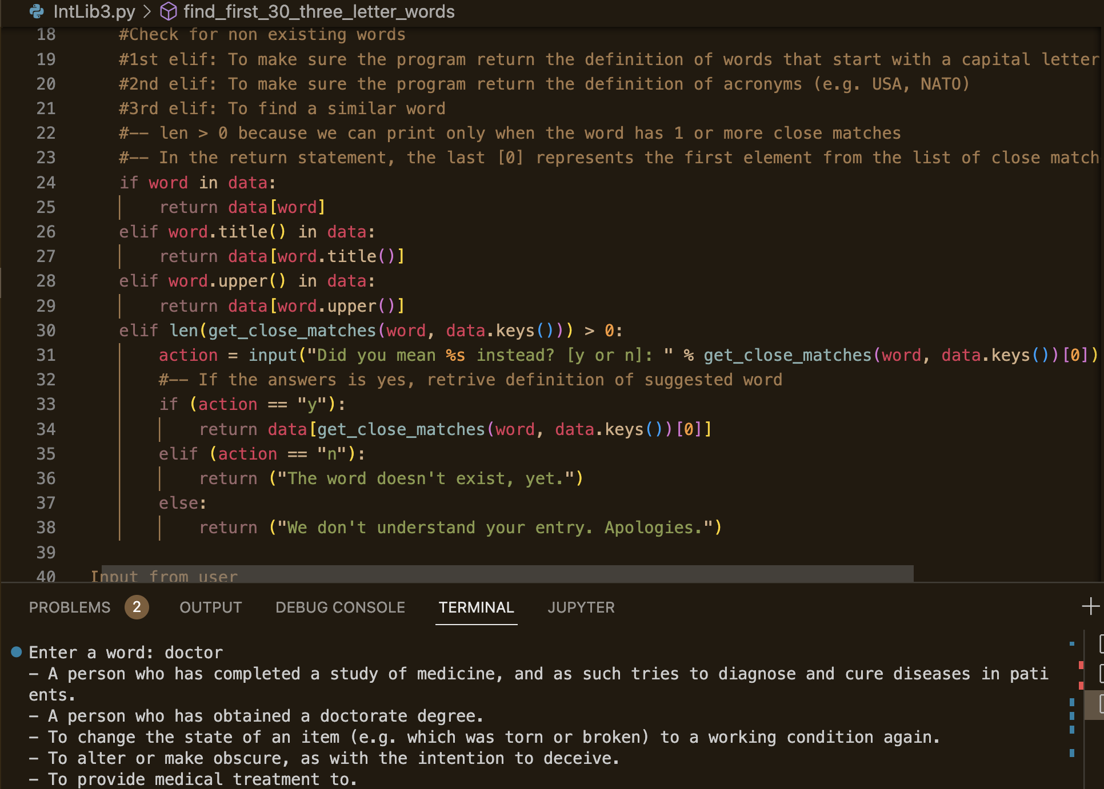
WordWhiz: Your Interactive Dictionary
Angelica Lewis, Shaniqua McNeil, Natasha Williams
Kennesaw State University
HMI 7540
Ready to revolutionize the way you engage with words? Join us on a journey where language meets innovation.
Let's redefine the art of expression together!
Dive into a dynamic, interactive world of words. Our app goes beyond definitions—each word is a doorway to a realm of knowledge, synonyms, acronyms, and other fascinating features.
Click Here for Word Whiz Github Repository

